Slide 1
Familial Transverse Myelitis Associated with Mutation in VPS37A Gene
Presented by: Michael Levy, MD, PhD

Slide 2
Disclosures
No meaningful disclosures
Notes:
I encountered my first NMO patient one night as a junior resident on the inpatient service. Back then most people in the US called it Devic’s disease. Or DevIC’s, because of this man, Dr Devic. But actually,
The very first case report of a patient with simultaneous optic neuritis and transverse myelitis was published in 1870 by Dr Allbutt in the Lancet. He was a British-born physician practicing in Montreal but I guess his name didn’t lend itself well. Allbutt’s disease never really got any momentum. Eugene Devic and his graduate student came along 24 years later and published a case series of 16 patients with simultaneous (or near simultaneous) optic neuritis and transverse myelitis and they suggested that we should call this disease neuromyelitis optica. But for the next 100 years, most people referred to it as Devic’s disease.

Slide 3
Transverse Myelitis: Definition
Acute
Idiopathic/ Post-infectious
Monophasic
From http://saintlukeshealthsystem.org
Notes:
I encountered my first NMO patient one night as a junior resident on the inpatient service. Back then most people in the US called it Devic’s disease. Or DevIC’s, because of this man, Dr Devic. But actually,
The very first case report of a patient with simultaneous optic neuritis and transverse myelitis was published in 1870 by Dr Allbutt in the Lancet. He was a British-born physician practicing in Montreal but I guess his name didn’t lend itself well. Allbutt’s disease never really got any momentum. Eugene Devic and his graduate student came along 24 years later and published a case series of 16 patients with simultaneous (or near simultaneous) optic neuritis and transverse myelitis and they suggested that we should call this disease neuromyelitis optica. But for the next 100 years, most people referred to it as Devic’s disease.

Slide 4
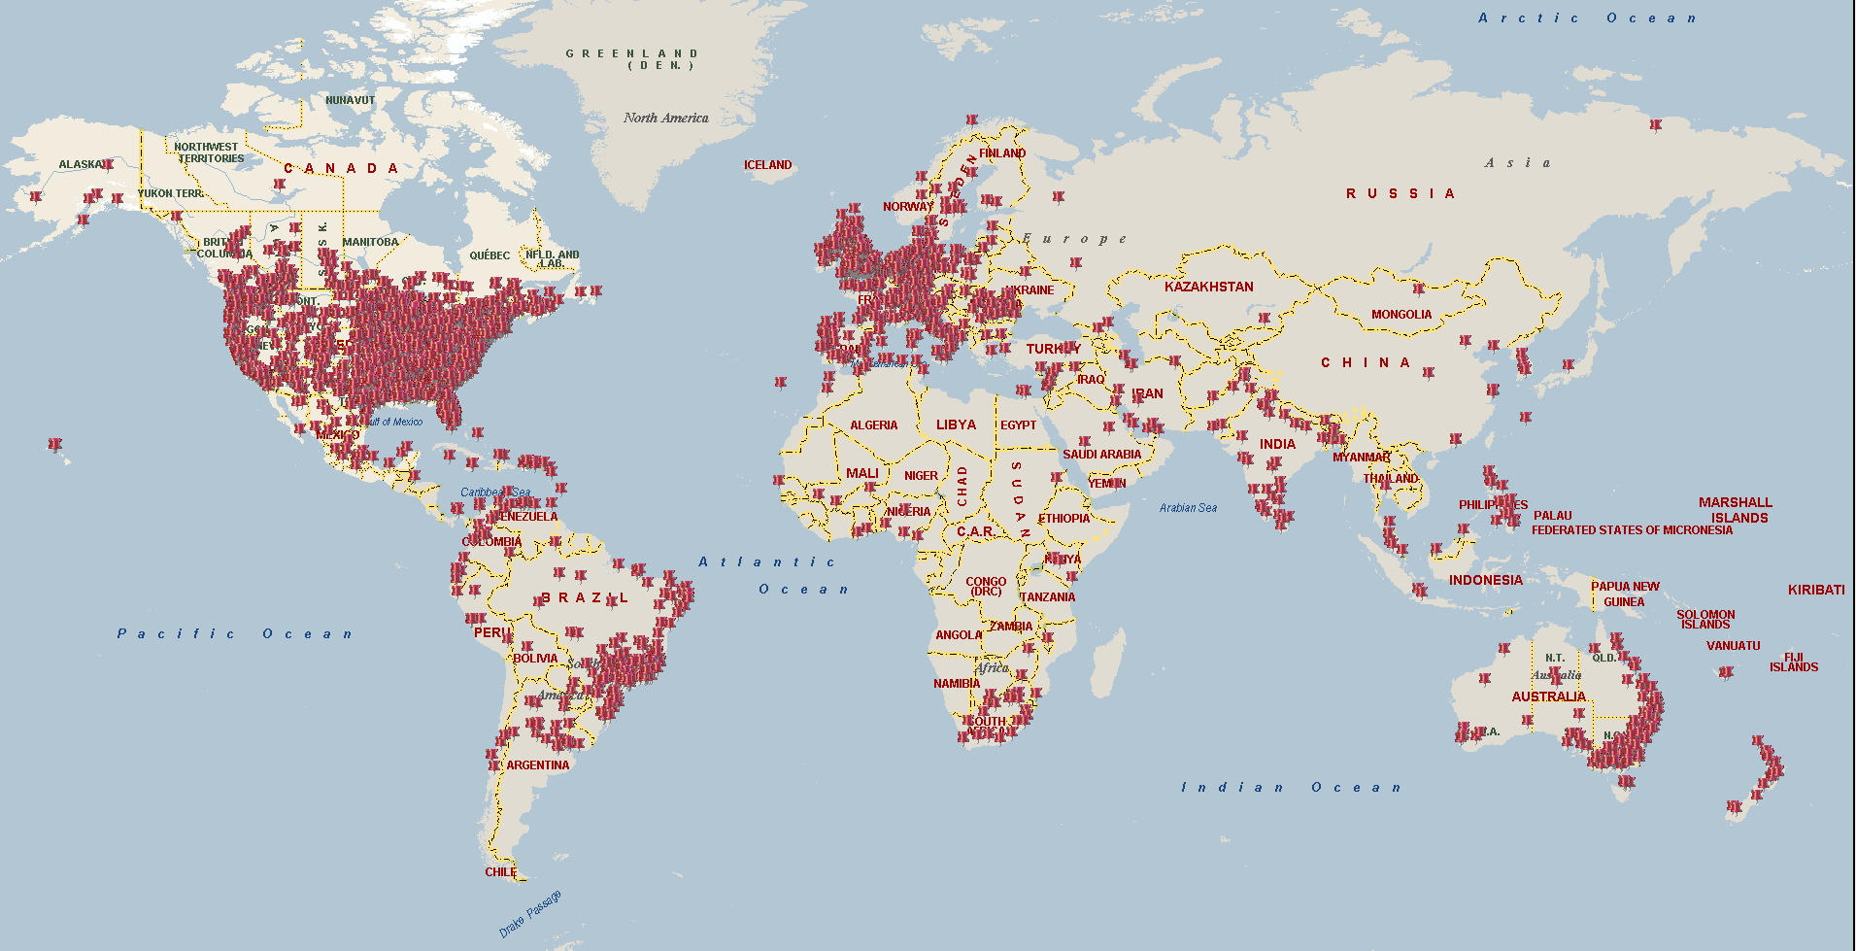
Transverse Myelitis: Epidemiology
Incidence: 0.1-0.8/100,000
Sex: 2F to 1M
Age: Bimodal
Race: Caucasian
Seasonality: None
Notes:
I encountered my first NMO patient one night as a junior resident on the inpatient service. Back then most people in the US called it Devic’s disease. Or DevIC’s, because of this man, Dr Devic. But actually,
The very first case report of a patient with simultaneous optic neuritis and transverse myelitis was published in 1870 by Dr Allbutt in the Lancet. He was a British-born physician practicing in Montreal but I guess his name didn’t lend itself well. Allbutt’s disease never really got any momentum. Eugene Devic and his graduate student came along 24 years later and published a case series of 16 patients with simultaneous (or near simultaneous) optic neuritis and transverse myelitis and they suggested that we should call this disease neuromyelitis optica. But for the next 100 years, most people referred to it as Devic’s disease.

Slide 5
Transverse Myelitis: Genetics

Slide 6
Opportunity: Two sisters with TM
Sister #1
Onset age: 15
Acute
Sensory/motor/bladder
Pre-MRI, CSF lost
Responded to course of steroids
2 year recovery back to walking

Slide 7
Opportunity: Two sisters with TM

Slide 8
Opportunity: Two sisters with TM
Sister #1
Sister #2
Onset age: 15
Acute
Sensory/motor/bladder
Pre-MRI, CSF lost
Responded to course of steroids
2 year recovery back to walking
Onset age: 50
Acute
Sensory/motor/bladder
MRI, no CSF
Responded well to steroids
Monophasic x5 years

Slide 9
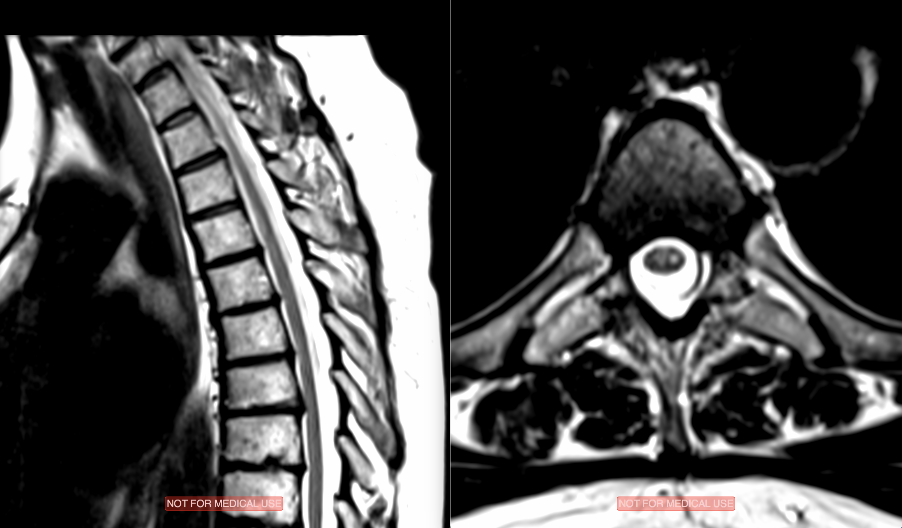
Opportunity: Two sisters with TM

Slide 10
Opportunity: Two sisters with TM
Sister #1
Sister #2
Onset age: 15
Acute
Sensory/motor/bladder
Pre-MRI, CSF lost
Responded to course of steroids
2 year recovery back to walking
Onset age: 50
Acute
Sensory/motor/bladder
MRI, no CSF
Responded well to steroids
Monophasic x5 years

Slide 11
Exome Sequencing
Exome capture: Baylor Human Genome Sequencing Center VCRome 2.1
Illumina Hi-Seq (San Diego, CA) instruments
Raw data: Mercury pipeline
Mapping: Burrows-Wheeler Alignment (BWA)
Recalibration: GATK
Variant Calls: Atlas2 suite
Annotation: Cassandra

Slide 12
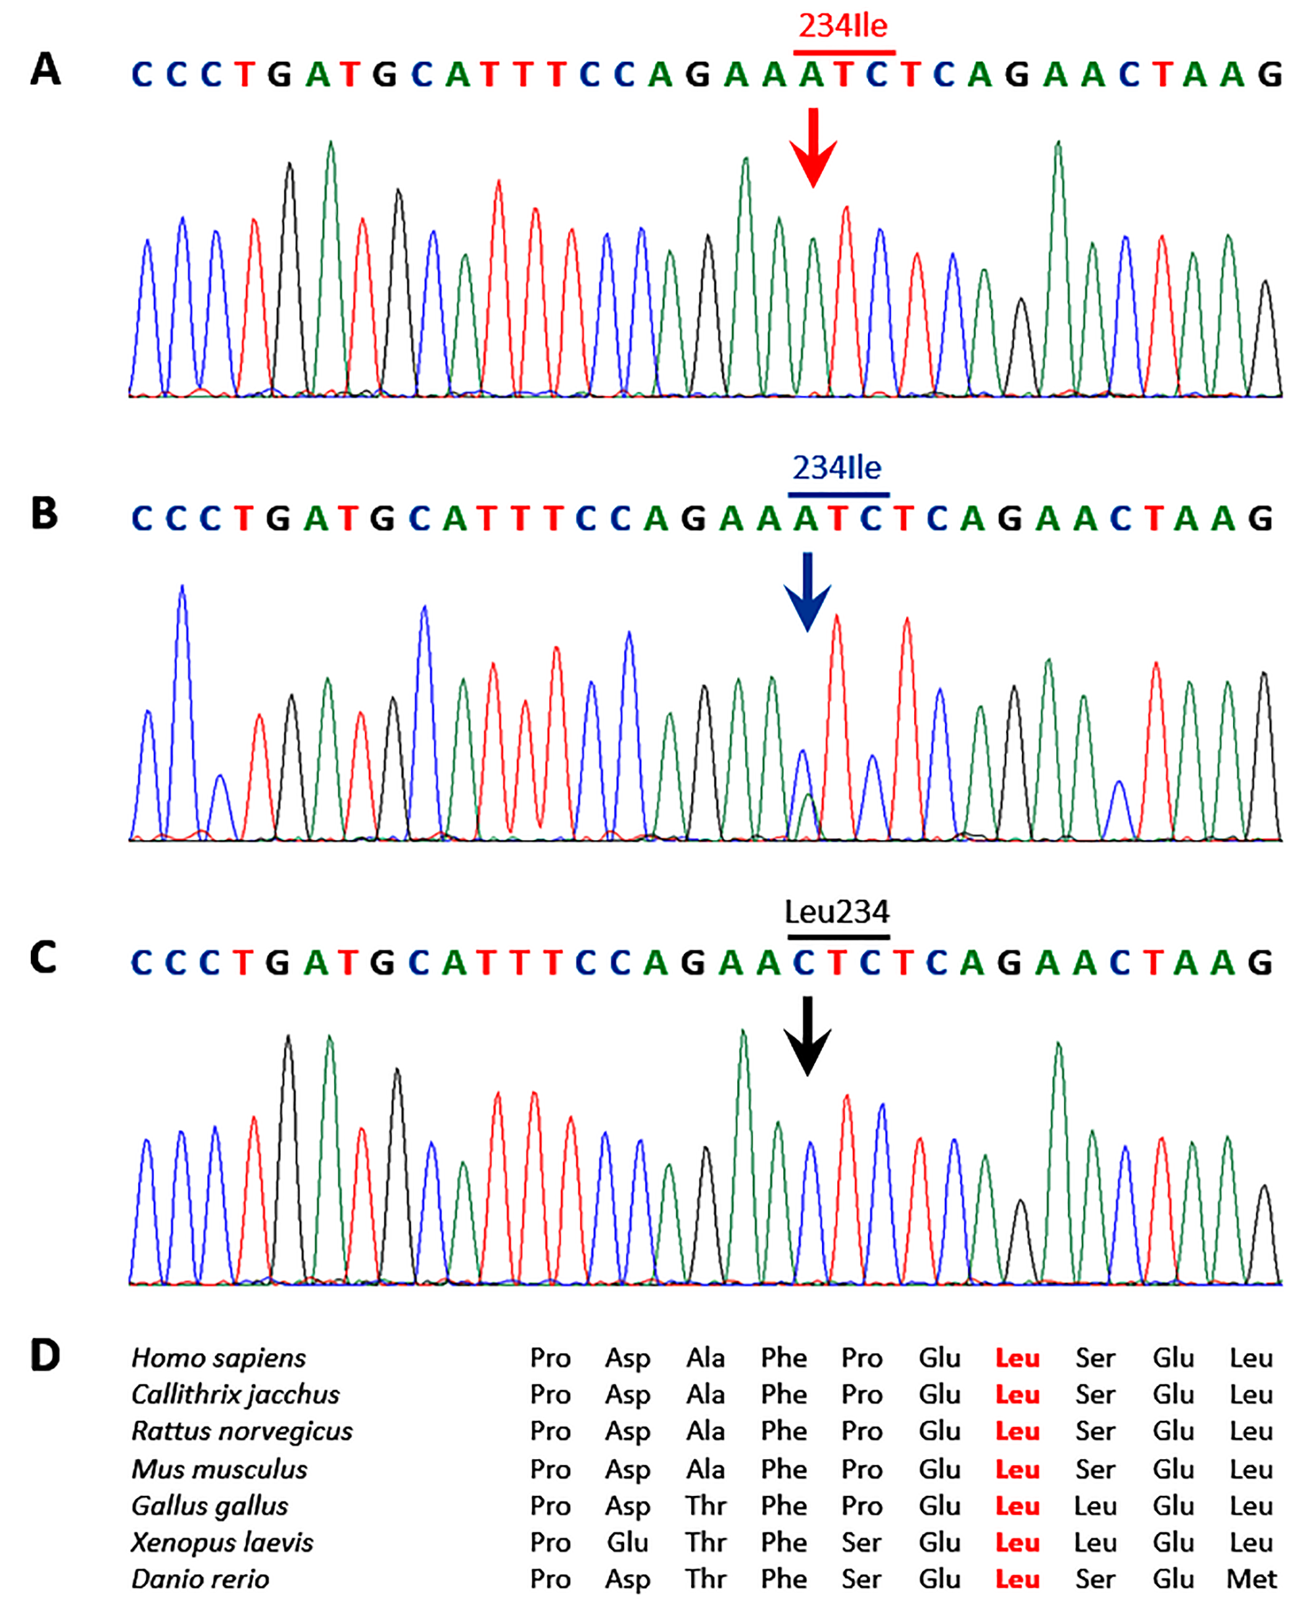
Gene Identified: VPS37A
Autosomal recessive
Very rare mutation in general population as heterozygote: 1/1,000
Expected frequency of homozygous mutation in general population is approx 1:4,000,000
None found in any reference populations
Both sisters have the autosomal recessive mutation
One brother is carrier, the other wild type and are both healthy
No other meaningful genetic differences
Unpublished

Slide 13
Screening of More Patients
Screened an additional - 86 TM - 25 NMO - 25 MS - 25 healthy controls
1 new TM patient found!

Slide 14
1 new familial TM patient
TM Patient
Onset age: 51
Acute
Sensory/motor/pain
MRI, CSF not done
Responded to course of steroids with residual pain

Slide 15
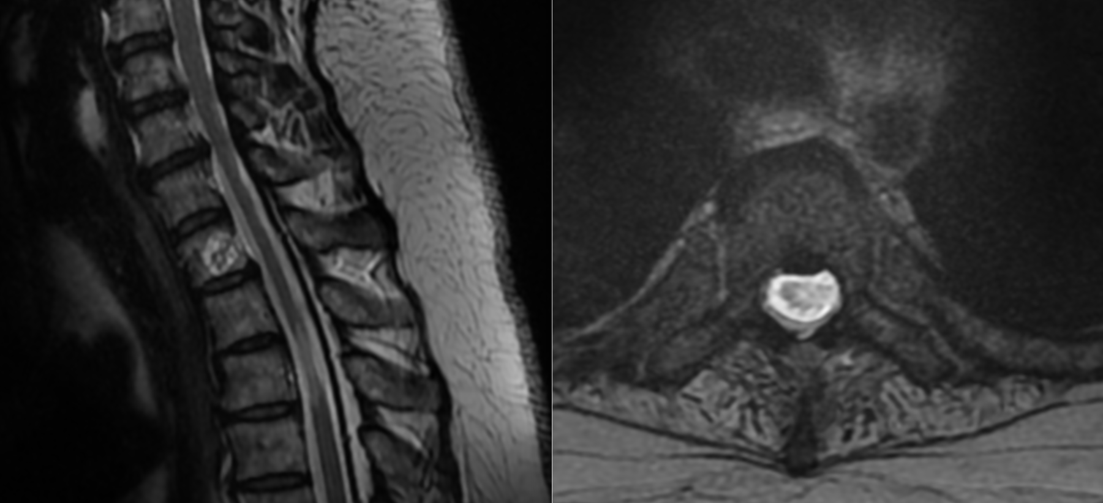
1 new familial TM patient

Slide 16
1 new familial TM patient
TM Patient
Onset age: 51
Acute
Sensory/motor/pain
MRI, CSF not done
Responded to course of steroids with residual pain

Slide 17
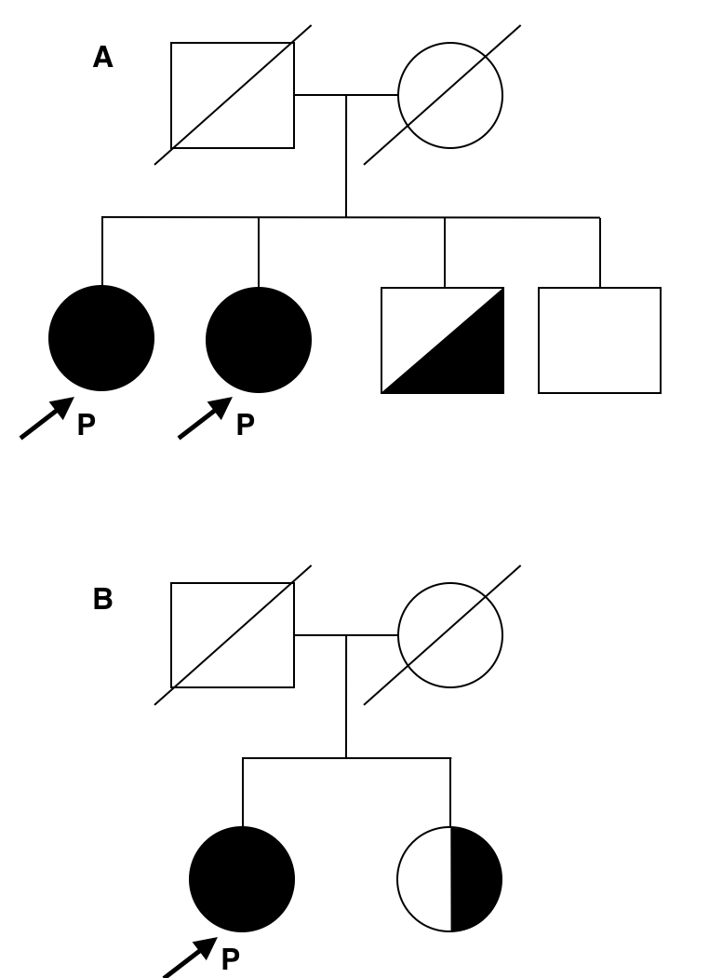
Family pedigrees
Heterozygous carriers suggests familial inheritance
Unpublished

Slide 18
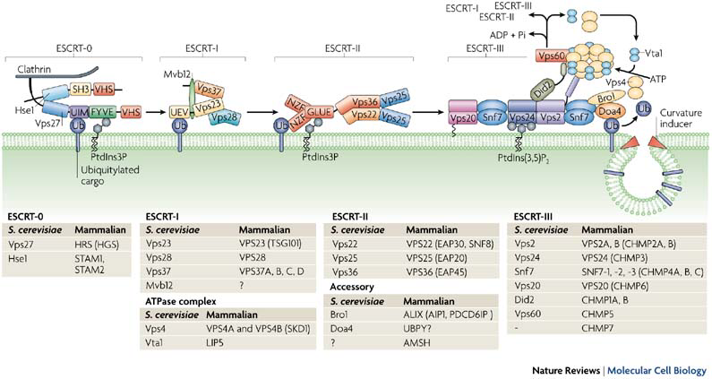
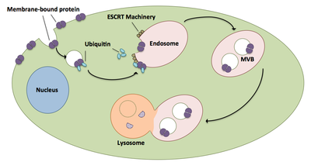
VPS37A: part of ESCRT vesicle recycling

Slide 19
VPS37A: Vacuolar Protein
Sorting 37A
From http://www.thermofisher.com

Slide 20
Diseases Associated with ESCRT Vesicle Recycling
Alzheimer’s
TSG101 of ESCRT-1
Parkinson’s, Motor Neuron Disease and Frontotemporal Dementia
CHMP2B of ESCRT3
Hereditary Spastic Paraplegia
Spastin ESCRT3
VPS37A: Lys382Asp

Slide 21
Mechanism in Autoimmunity
Unpublished

Slide 22
Summary
Familial TM: 3 cases/88
Mutation in VPS37A
Autosomal recessive
Vesicle recycling
Mechanism unknown
Notes:
Summary

Slide 23
Acknowledgments
Johns Hopkins University Santiago Pardo Maureen Mealy, RN Kathleen Burns, MD, PhD David Valle, MD Dimitri Avramopoulos, MD, PhD Douglas Kerr, MD, PhD Carlos Pardo, MD
Chonnam National University Tai-Seung Nam, MD, PhD
Transverse Myelitis Association Sandy Siegel Jim Lubin
Notes:
Summary

Slide 24
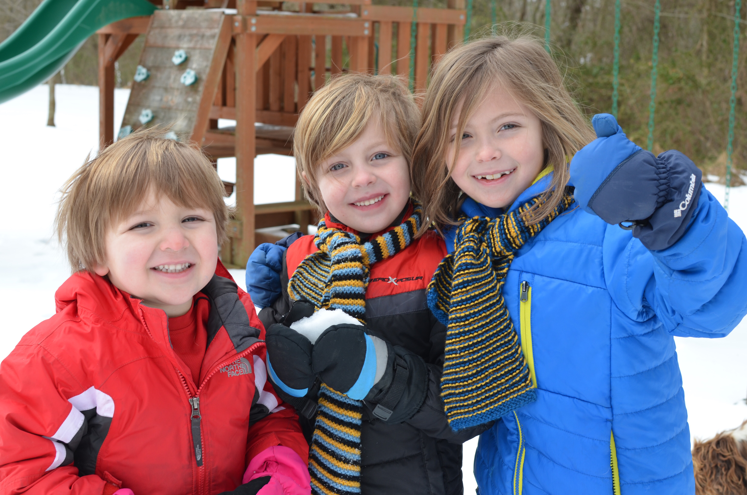
Questions?
Notes:
Summary

